Slide 1

UNDERSTANDING THE BARRIERS TO VOTING AND CRAFTING A PATH FORWARD
An Analysis for Voting Behavior.
Recommendations for Increased Participation
Presented By :
IRSHAD
K.INDUMATHI

Slide 2
2
OVERVIEW
Purpose
Methodology
A Troubling Trend
Barrier #1 : Racism
Barrier #2 : Disconnect
Barrier #3 : Barriers to Community Participation
Barrier #4 : Voting Process: Personal Issues
Barrier #5 : Confidence in voting method
Technical Appendix

Slide 3
Purpose of the Analysis
Analyze barriers to voting among workers to develop strategies for increased participation.
Many workers face challenges that prevent them from voting, including systemic issues and disconnects with leadership.
Imagine workers eager to shape their future, yet held back by obstacles. Our goal is to uncover these barriers and find a path forward.

Slide 4
Methodology
Statistical analysis to identify correlations between voting behavior and factors such as:
Perceptions of racism
Leadership engagement
Community involvement
Confidence in voting methods
Data analysis and visualization conducted with python and flourish

Slide 5
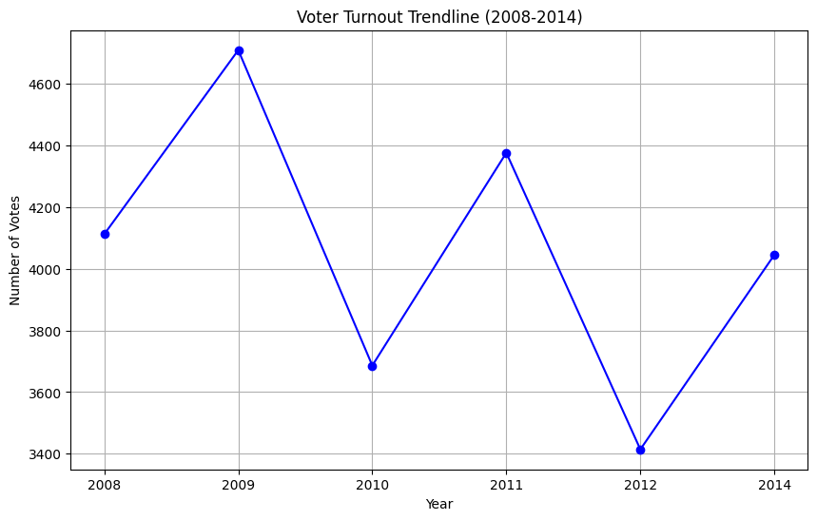
A Troubling Trend
Over the past several years, we've witnessed a troubling decline in voter turnout.
The trend represents a steady erosion of engagement among our workers—a clear signal that something is deeply wrong.
Each drop in this curve signifies the silenced voices of workers whose dreams, struggles, and aspirations were left unheard. These are the voices that should have shaped the direction of their future, but instead, their concerns went unaddressed, and the opportunities for change were missed due to the insurmountable barriers they faced
As we move forward, this graph serves as a stark reminder that we must act now to reverse this trend. We must understand and address the barriers that are keeping our workers from the polls, for the health of our democracy depends on it.

Slide 6
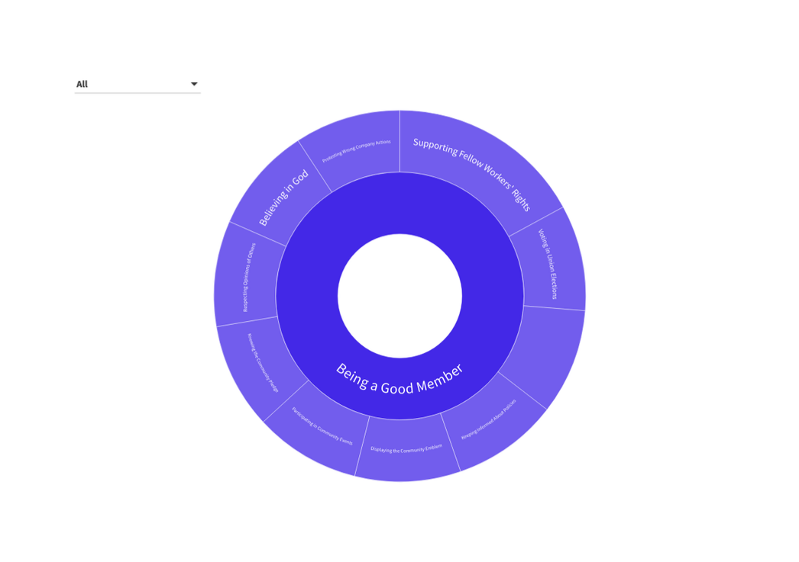
Understanding to What Truly Matters
To truly break down the barriers, we need to delve deeper into the heart of our community and understand the values that resonate with our workers.
This is not just about statistics or trends; it's about the essence of what it means to be part of a collective—a community where every voice, every choice, should matter.
So with every step forward, we must constantly remind ourselves of what truly matters to each union worker.
With this graph we try to uncover how different groups of voters perceive the importance of various community activities.
These insights are not just numbers on a chart; they reveal the underlying motivations that either draw workers closer or push them away.

Slide 7
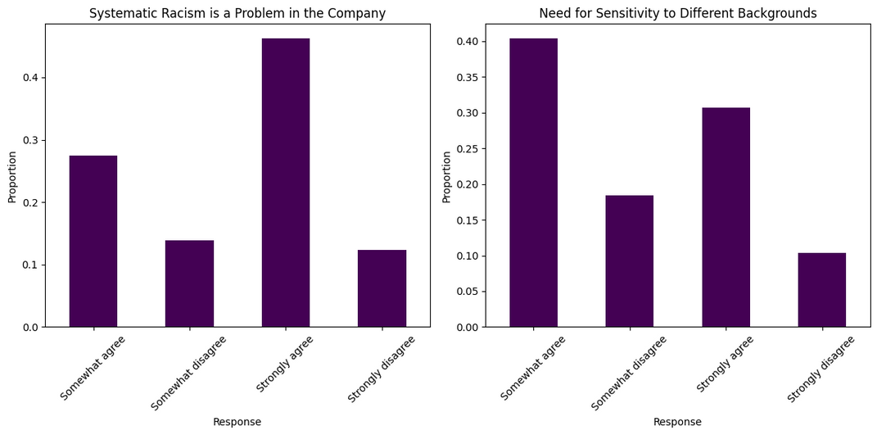
The Urgency of Addressing Racism and Sensitivity
As we delve deeper into the barriers that hinder voter participation, one significant factor stands out: systemic racism.
Our journey reveals how this pervasive issue casts a long shadow over voter engagement.
Low voter turnout reflects the profound impact of these unequal experiences within our society.
Systemic Racism: A trend highlighting voters' strong agreement that systemic racism is a significant issue, revealing a deep-seated concern that is being overlooked.
Need for Sensitivity: Additionally, these voters express a critical need for more sensitivity towards people from different backgrounds, suggesting that both union and company leadership are not adequately addressing these concerns.
Implications for Union Leaders:
Failure to Act: Union leaders are failing to address the pressing issues of racism and sensitivity.
Urgency: With 44% of voters being sporadic, this is an urgent issue that must be tackled to break down these barriers and foster greater engagement."

Slide 8
Path Forward
Recognition of Systemic Racism: Acknowledge that systemic racism is a significant barrier to voter participation.
The data indicates that voters are highly concerned about systemic racism and believe it is a critical issue that needs to be addressed.
Need for Increased Sensitivity: There is a strong demand for more sensitivity towards diverse backgrounds. The lack of appropriate responses from union and company leadership suggests a gap in addressing these concerns effectively.
Actionable Steps for Council Leaders:
1.Implement Anti-Racism Training:
Develop and Mandate Training Programs: Introduce comprehensive anti-racism and cultural sensitivity training for all council members and staff.
2. Enhance Engagement with Diverse Communities:
Establish Outreach Initiatives: Create targeted outreach programs to engage with underrepresented and marginalized communities.
Work to understand their specific barriers to voting and address them directly.

Slide 9
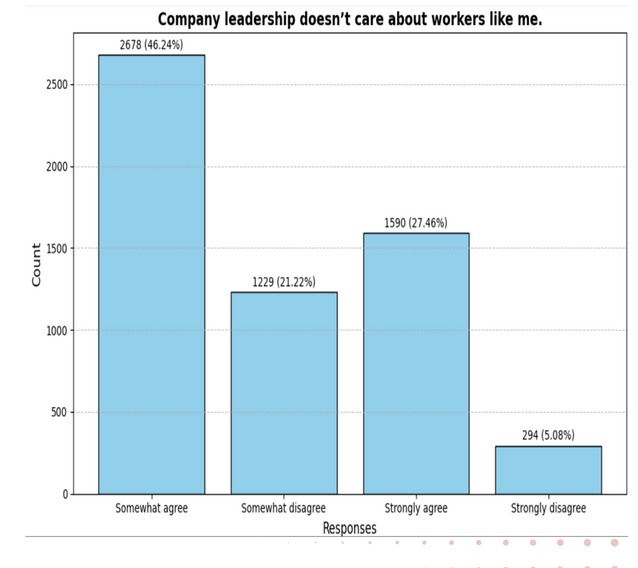
The Disconnect Between the Workers and the Company Leaders
As we continue to explore the barriers to voting, another critical issue comes to light:
the perceived disconnect between workers and their leaders.
Workers’ Perception: Nearly 47% of workers somewhat agree that company leaders do not care about them.
Impact on Voter Engagement: This issue is as significant as any other barrier we’ll discuss.
The belief that leadership is indifferent to their voices erodes trust and discourages participation, leading to voter apathy.

Slide 10
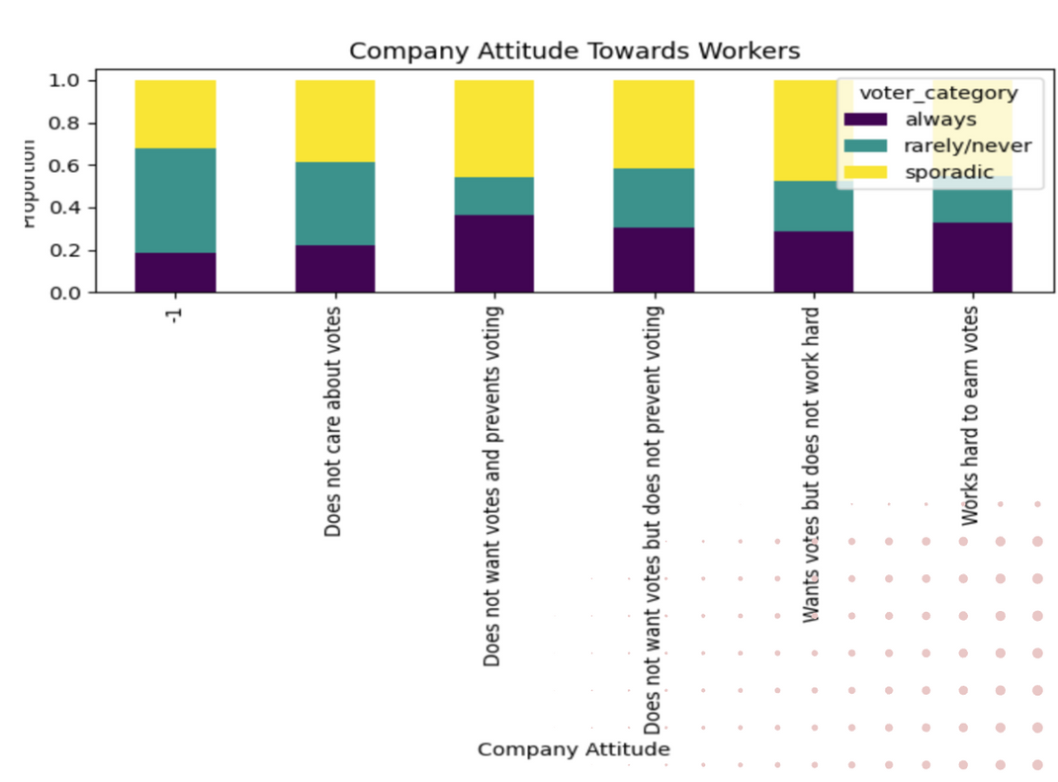
The Disconnect Between the Workers and the company Leaders
Workers’ Perception: Nearly 47% of workers somewhat agree that company leaders do not care about them.
This perception is particularly strong among those who rarely or never vote, who overwhelmingly believe that the company not only disregards their concerns but also indirectly prevents them from voting.
Leadership's Role: Just as the disconnect between union leaders and workers affects voter turnout, the company's leadership must recognize that their relationship with the worker community directly impacts workers’ motivation to vote.
Fostering genuine connections and showing a commitment to addressing worker concerns is crucial to overcoming this barrier and encouraging greater voter participation."

Slide 11
Why this Disconnect matters and how it influences voting behavior
1.Erosion of Trust and Engagement:
Trust Deficit: Nearly 47% of workers feel that company leaders do not care about them. This perception undermines trust in leadership and can extend to union leaders. When workers believe that leadership is indifferent, they are less likely to see value in engaging with or supporting leaders who are perceived as part of the same system of disregard.
Voter Apathy: Workers who feel neglected are more likely to disengage from voting altogether. If they believe that their vote will not result in meaningful change or that leaders are indifferent to their concerns, they may abstain from voting, including in union elections.
2. Impact on Union Election Outcomes:
Perception of Union Leaders: The same distrust affecting company leadership can be projected onto union leaders, especially if there is a perceived alignment between the two. Workers may see union leaders as ineffective or as part of a system that fails to address their needs, further discouraging participation in elections.
Reluctance to Support Change: Workers who feel disconnected from leadership may be reluctant to support new or reformist union leaders if they perceive no real difference in addressing their concerns. This reluctance can skew election results and perpetuate a cycle of disengagement.

Slide 12
Path Forward
Enhanced Communication: Implement regular, transparent communication channels between leadership and workers.
This can include town hall meetings, feedback surveys, and open-door policies
Address Worker Concerns: Develop and execute action plans based on feedback from workers.
Showing tangible improvements in areas of concern can help rebuild trust.
Collaborative Initiatives: Foster collaborative efforts where both union and company leadership work together to address worker issues.
This can help bridge the gap between workers and leadership and demonstrate a united front in addressing worker needs.

Slide 13
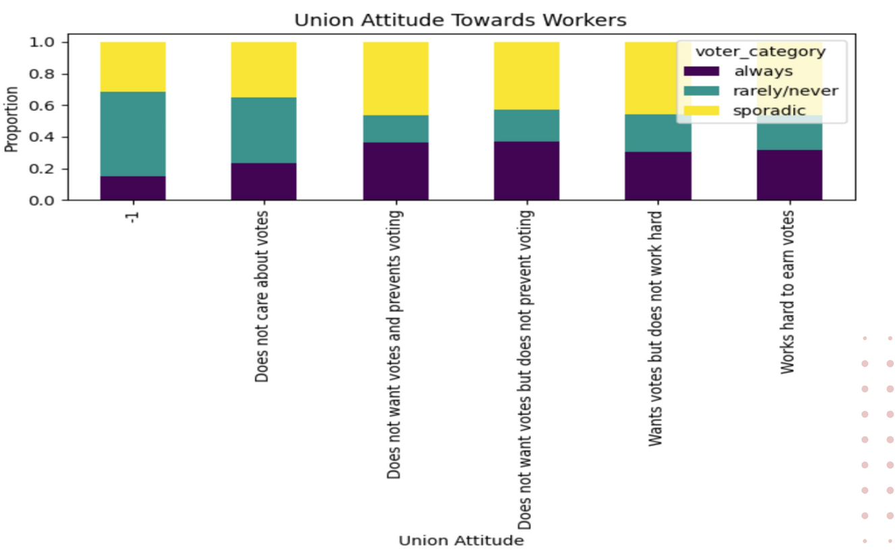
The Disconnect Between the Workers and the Union Leaders
As we shift our focus to the union leadership, it's crucial to acknowledge another significant barrier to voting— the disconnect between workers and those who are supposed to represent them.
Perception of Indifference: A large proportion of workers who rarely or never vote believe that union leaders do not want their votes.
This perception is particularly strong among those who are disengaged from the voting process.

Slide 14
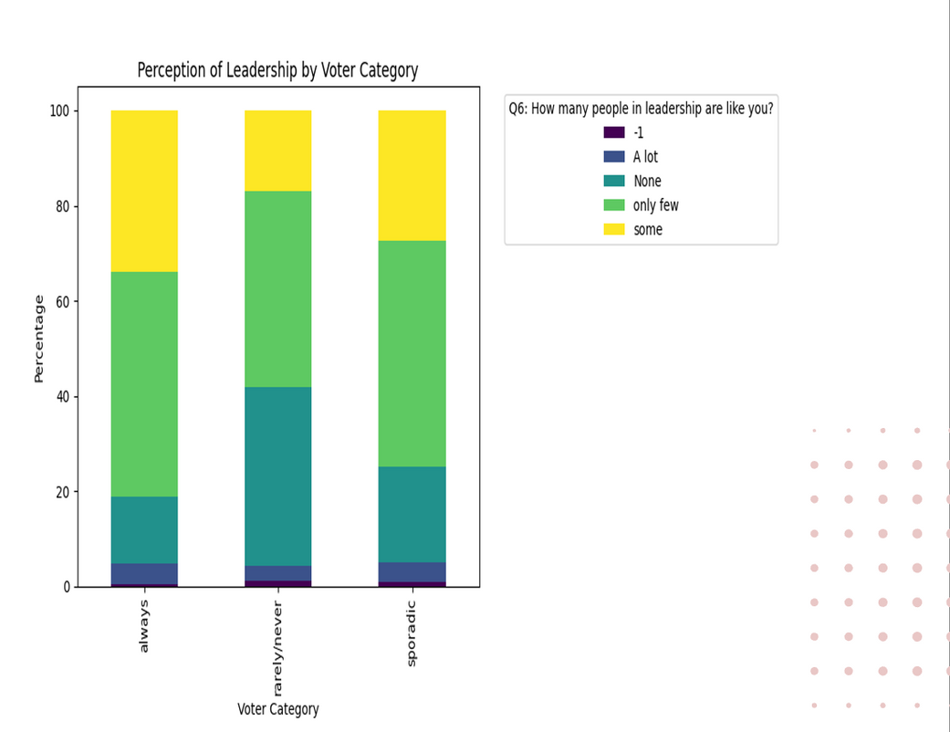
The Disconnect Between the Workers and the Union Leaders
Lack of Representation: Additionally, a significant number of these workers feel that there are very few leaders within the union who are like them.
This sense of alienation suggests that they do not feel understood or represented by the current leadership.
Implications for Voting Behavior: These feelings of being overlooked and misunderstood contribute to a sense of futility among workers.
They may believe that even if they participate in the voting process, electing someone will not lead to meaningful change or solutions to their problems.

Slide 15
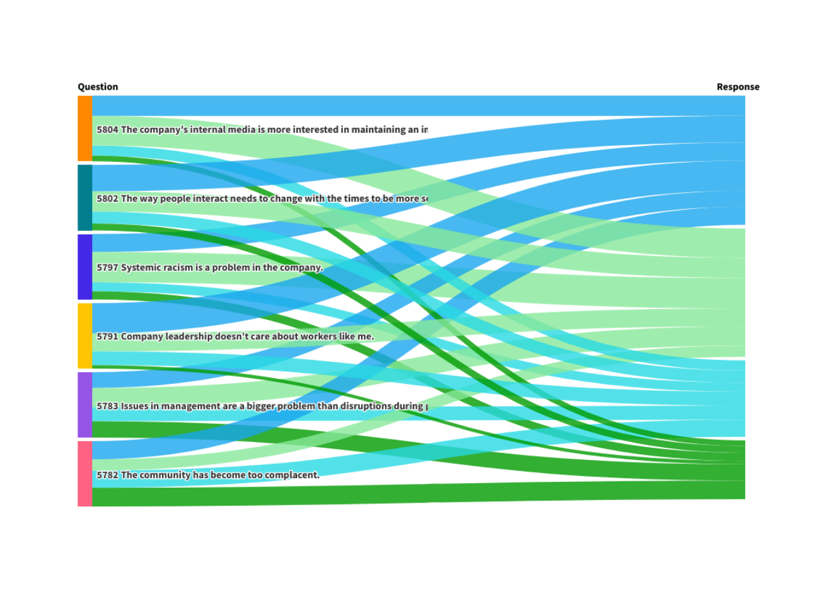
Path Forward
Regular Updates: Implement consistent and transparent communication channels, such as newsletters, social media updates, and town hall meetings.
Ensure these platforms are accessible and provide regular updates on union activities, decisions, and how worker concerns are being addressed.
Feedback Mechanisms: Create multiple avenues for workers to voice their concerns and suggestions.
This can include anonymous surveys, suggestion boxes, and regular listening sessions with union leaders.
Inclusive Representation: Actively seek and promote leaders within the union who reflect the diversity and concerns of the worker base.
Ensure that union leadership includes representatives from various worker demographics to enhance relatability and understanding.
Engagement Initiatives: Launch initiatives aimed at increasing worker engagement, such as workshops, focus groups, and community events where workers can interact with union leaders and discuss their concerns in person.

Slide 16
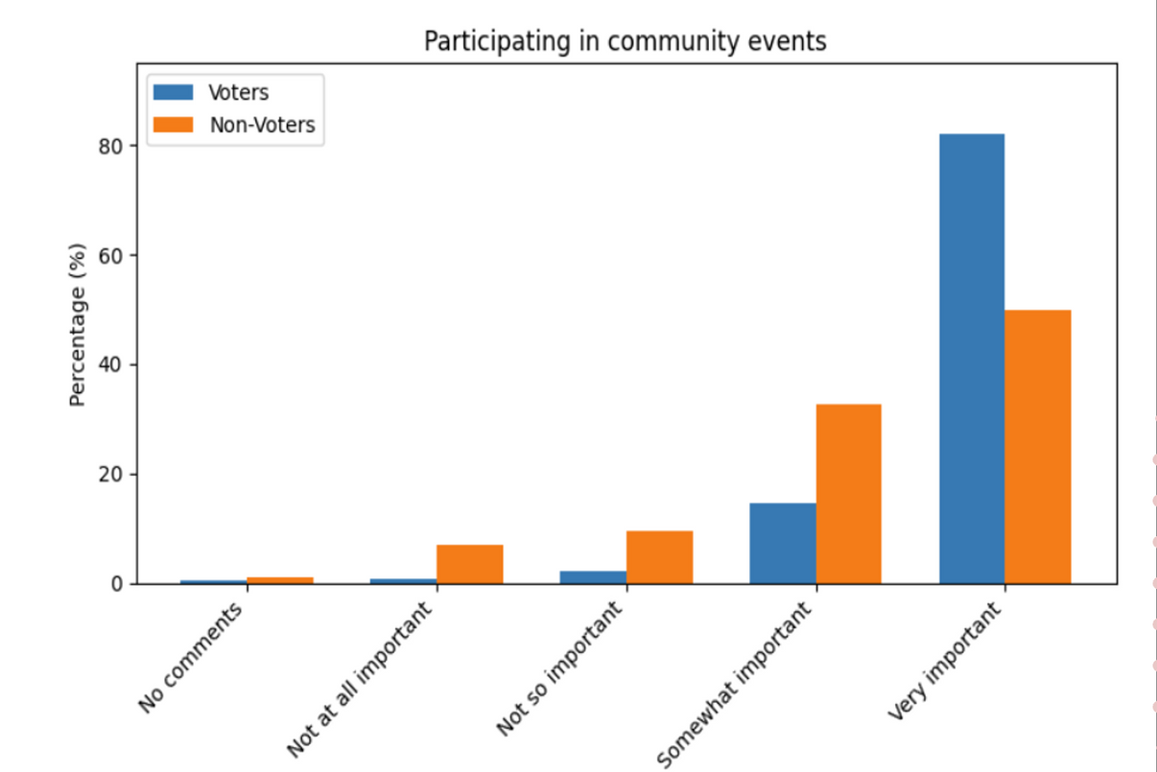
The Power of Community and the Barriers to Participation
•Fostering a Sense of Belonging:
"Community activities are vital in creating a sense of belonging and fostering engagement among workers.
•These events bring individuals together, strengthening their connection to the union and the broader worker community.
• Our analysis shows that workers who actively participate in community meetings are more likely to vote, highlighting the positive impact of these activities on voter turnout."

Slide 17
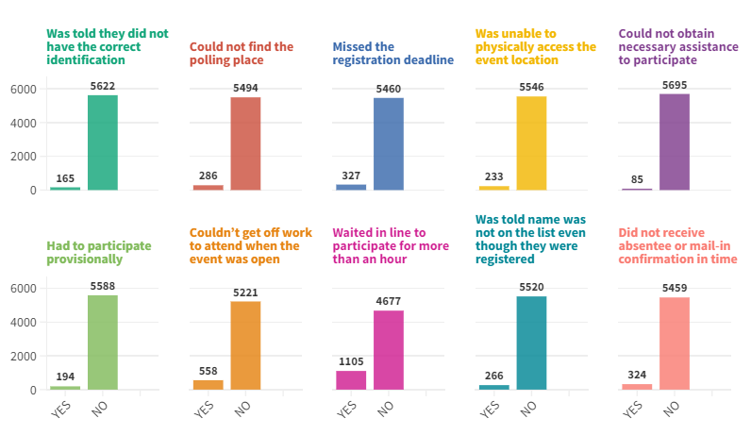
The Power of Community and the Barriers to Participation
•Challenges to Participation: All are excuses

Slide 18
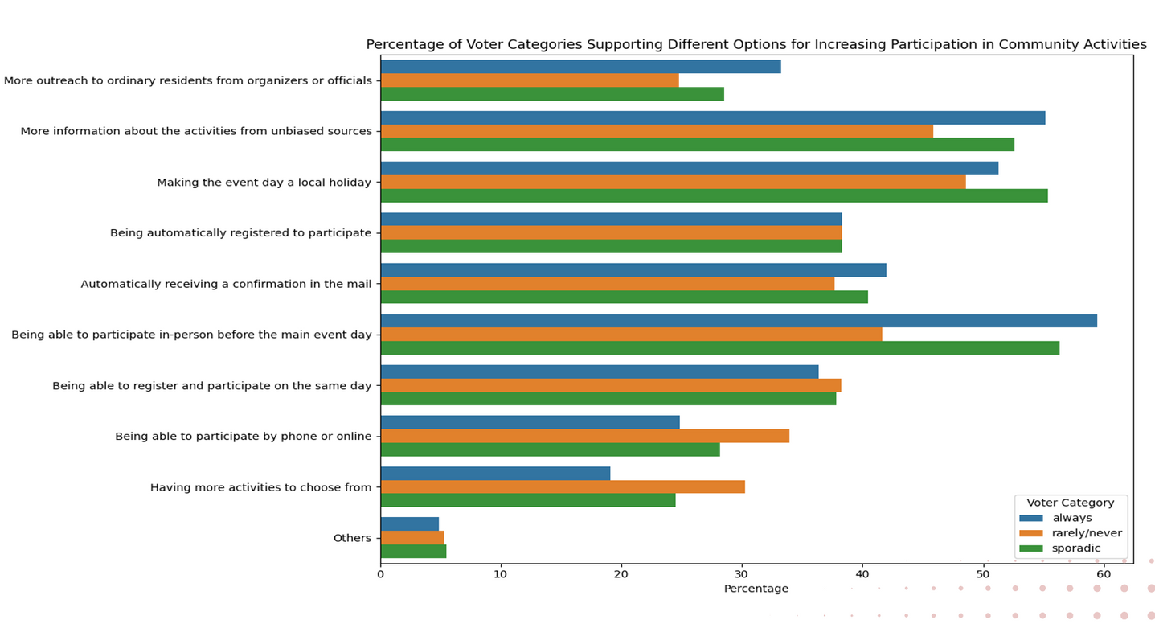
The Power of Community and the Barriers to Participation
•Implications for Voter Engagement:
To increase voter turnout, it's essential to make community involvement more accessible to all workers.
•By addressing these challenges—whether through flexible scheduling, remote participation options, or other innovative solutions—we can ensure that more workers feel connected, engaged, and motivated to participate in elections.

Slide 19
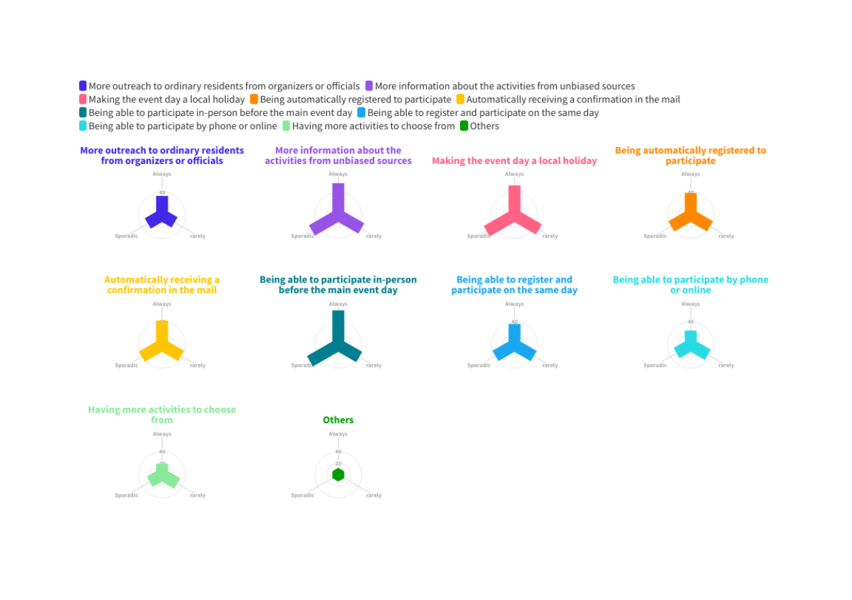
Path Forward
•Targeted Outreach: Focus on increasing outreach to ordinary residents through community organizers and officials. Given that those who engage rarely or never in voting show lower outreach, targeted efforts to these groups can improve participation.
•Information Dissemination: Ensure that information about activities and voting processes is distributed through unbiased and credible sources. Given that those who engage always in voting show a higher reliance on unbiased information, make sure all communications are clear and objective.
•Local Holiday Implementation: Advocate for making election days or key community events local holidays. This could increase participation rates, as evidenced by the higher turnout among those who always vote when event days are holidays.
•Activity Variety: Provide a range of community activities to cater to different interests and age groups. As seen from the data, having more activities to choose from can help increase engagement.
•Enhanced Community Engagement: By fostering a more inclusive and interactive environment, community engagement can be improved, which in turn supports higher voter involvement.

Slide 20
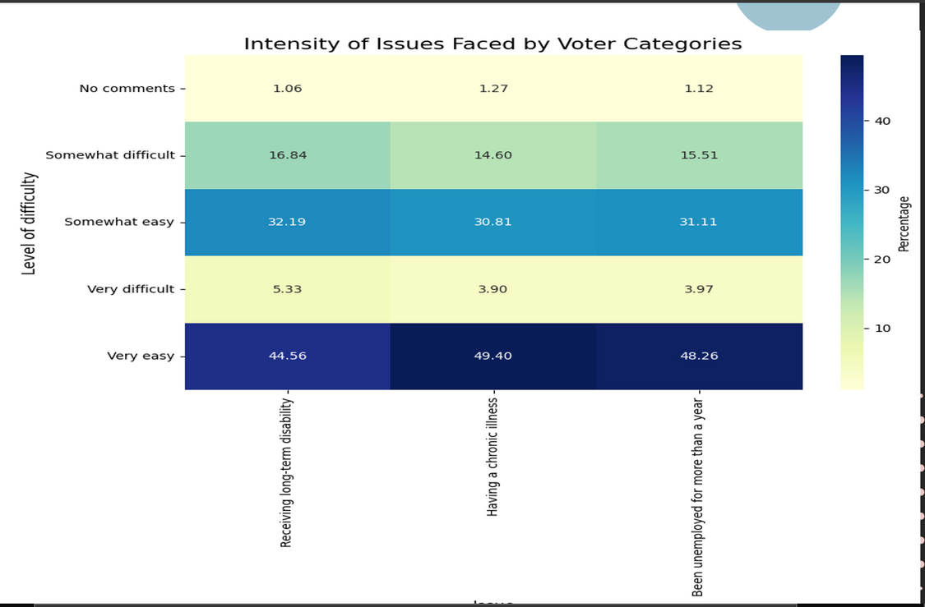
The Challenge of voting with Personal Barriers
Voting is a fundamental right and a critical way for individuals to shape the future of their communities.
However, not everyone has equal access to this right.
Our analysis shows that most of the people with these challenges can and do vote, demonstrating that participation is possible even under difficult circumstances.
Critical Concern: However, there remains a t portion of this population for whom voting is either extremely difficult or entirely impossible due to their personal circumstances.
Vision: We should aim to eliminate any barriers that prevent people from voting due to solvable problems.

Slide 21
Path Forward
Conduct Research: Perform detailed research to identify specific barriers faced by different populations.
This can include surveys, interviews, and data analysis to understand the unique challenges individuals face.
Categorize Barriers: Classify barriers into categories such as physical access, logistical issues, financial constraints, or socio-political obstacles.
Improve Polling Locations: Ensure that polling stations are accessible to individuals with disabilities, including those with mobility challenges.
This includes providing ramps, accessible voting machines, and assistance on-site.
Expand Early Voting and Mail-In Options: Offer early voting and mail-in ballot options to accommodate those who may have difficulties voting on the designated day, such as people with health issues or work commitments.

Slide 22
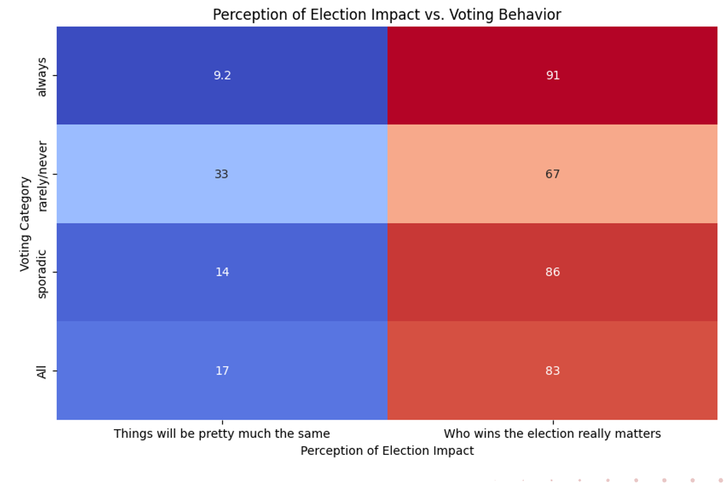
Impact of the Election
Across different voter categories—whether they "always," "sometimes," "rarely," or "never" vote—there is a shared belief that the outcome of elections truly matters.
Insight: This suggests that regardless of how often people vote, there is a general consensus that the results of an election have a significant impact on their lives and the broader community.

Slide 23
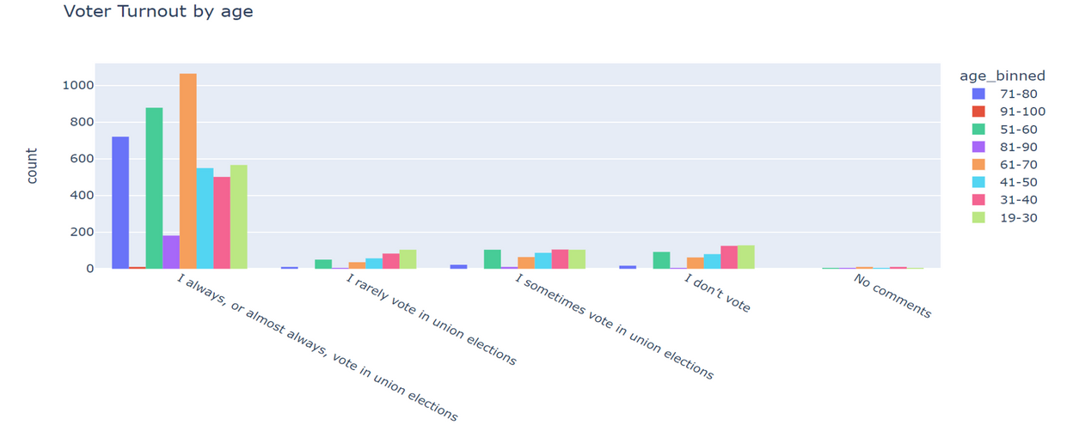
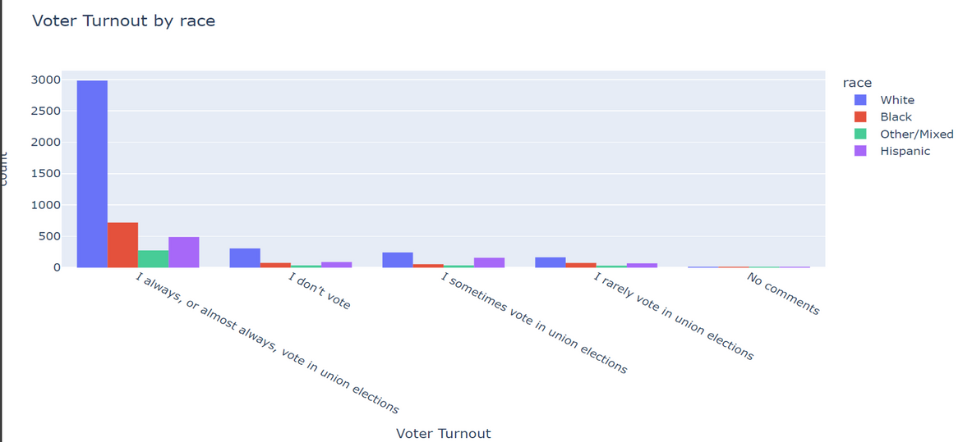
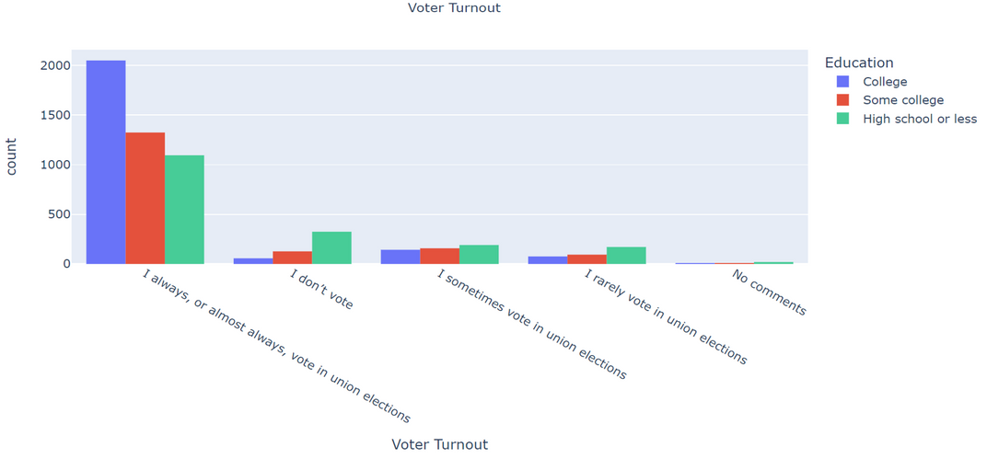
Impact of the Election
Puzzling Trend: If most voters believe that the outcome of elections is important, then why do we still see low voter turnout, especially among certain demographics?
Possible Explanation: Could it be that different demographic groups do not trust the voting process?

Slide 24
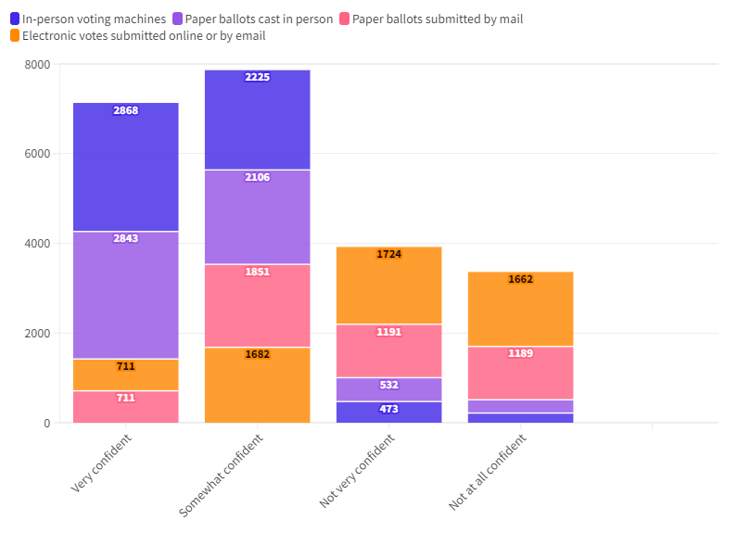
Confidence in Voting Methods and the Role of Perception
Voter trust in the integrity and reliability of voting methods is crucial for participation in elections.
Challenge: While there are four different voting methods available, not all of them are trusted equally by the electorate.
This disparity in trust can significantly impact voter turnout, as individuals may choose not to vote if they lack confidence in the selected method.

Slide 25
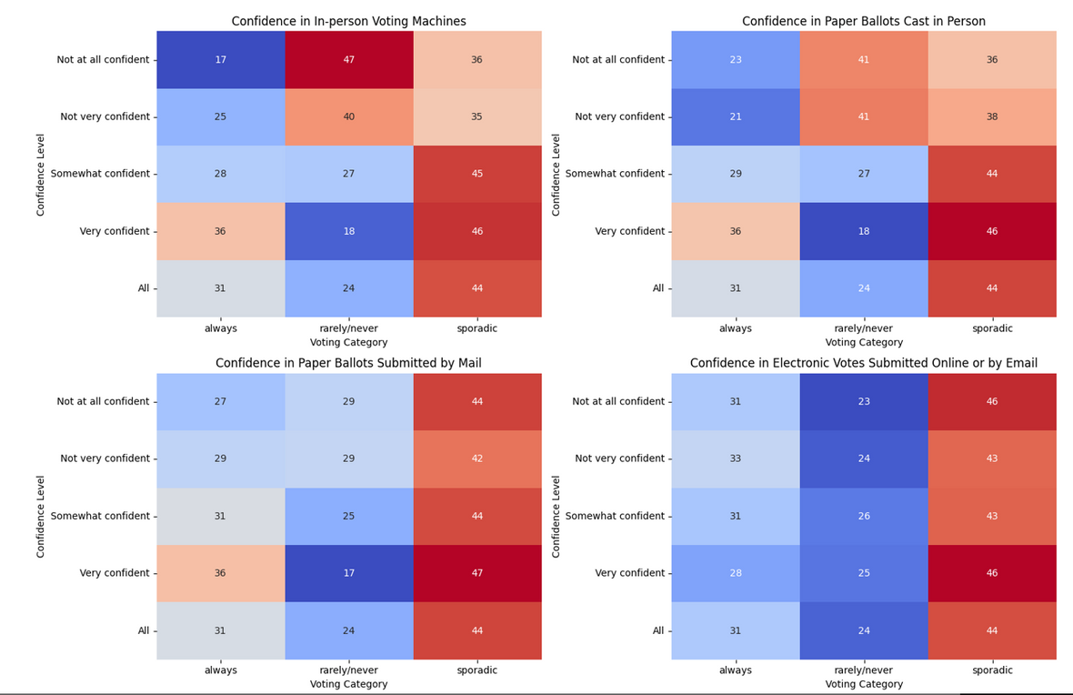
Confidence in Voting Methods and the Role of Perception
Voting Methods Overview: The four available voting methods include in-person voting machines, paper ballots, mail-in voting, and electronic voting.
Disparity in Trust: Our data shows that voters have varying levels of trust in these methods:
In-Person Voting Machines: Generally trusted, especially by those who “sporadically" vote.
Paper Ballots: Also trusted, often seen as reliable by a broad range of voters.
Mail-In Voting: Trust varies, might with some concerns about security and fraud.
Electronic Voting: Faces the least skepticism, particularly among who rarely vote.

Slide 26
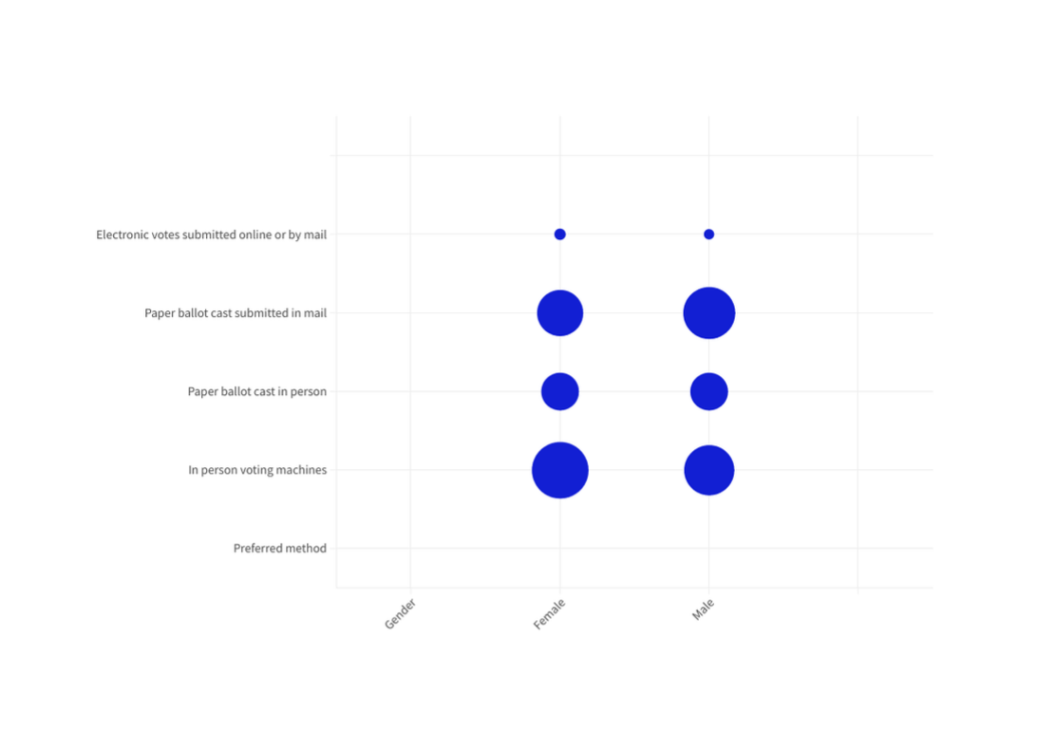
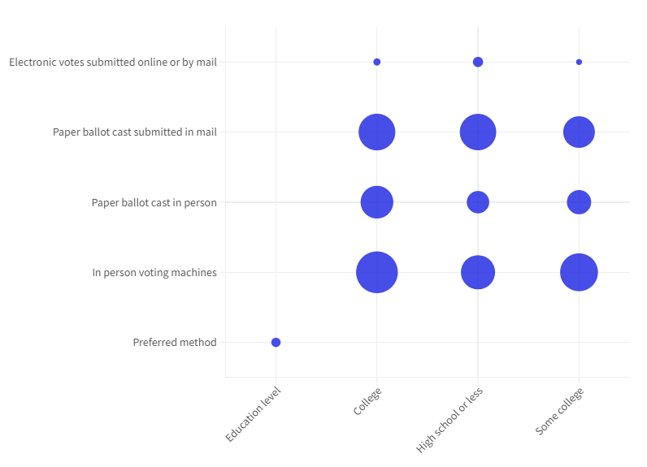
Confidence in Voting Methods and the Role of Perception

Slide 27
Confidence in Voting Methods and the Role of Perception
Our analysis reveals a significant trend in voting method confidence:
Highly Educated Individuals: Demonstrate the lowest confidence in in-person voting methods.
Younger Population: shows high skepticism towards in-person voting.
This might be a plausible reason for them not to vote
This pattern highlights a critical issue with in-person voting methods, particularly among those who are more informed and educated.
Their skepticism underscores potential problems with the current in-person voting processes and suggests a need for reform to address the concerns of these key demographics.

Slide 28
Path Forward
Identify Key Issues: Determine the root causes of mistrust, such as concerns about security, fraud, or the accuracy of vote counting.
Improve In-Person Voting Processes: Upgrade and maintain voting machines to ensure they are secure and reliable.
Conduct regular audits and tests to verify their accuracy.
Strengthen Mail-In Voting Procedures: Implement measures to improve the security and reliability of mail-in voting, such as better tracking systems, secure ballot processing, and clear instructions for voters.
Secure Electronic Voting Systems: Invest in advanced cybersecurity measures and conduct regular security assessments to protect electronic voting systems from potential breaches.
Transparency Campaigns: Launch educational campaigns to inform voters about the integrity and security of different voting methods. Provide clear, factual information on how each method works and the measures in place to ensure a secure voting process.
Targeted Outreach: Focus on highly educated individuals and younger populations to address their specific concerns about in-person voting methods. Tailor communication strategies to these groups to rebuild confidence.

Slide 29
3
Technical Appendix

Slide 30
Q&A

Slide 31
THANK YOU

